Slide 1
3D Game Development BFS & DFS Algorithms
Cert IV Information Technology (Game Development)
South Metropolitan TAFE | ian.bell@smtafe.wa.edu.au

Slide 2

In this session:
An overview of the BFS (Breadth-First Search) and DFS (Depth First Search) Algorithms
Explanation on how both algorithms search through graphs
Demonstration of finding a path using BFS in a ‘regular’ grid
Demonstration of finding a path using DFS in the same grid
Comparison & discussion of the paths found
Activities: Working through different grids to find paths

Slide 3
Breadth First Search
BFS uses a ‘queue’ system
The queue is first in, first out
Will search an entire graph by checking each neighbour/child of the ‘current node’ before moving on to the next ‘layer’
From the starting node:
Designate ‘current node’ as the node being checked
Check if ‘current node’ is the destination
If the ‘current node’ is the destination then return the ‘path list’
Add the children/neighbours of the current node to the queue if they have not been checked
Assign current node as ‘parent’ of the children/neighbours if they have not already been checked
Select the next node in queue & repeat

Slide 4
Depth First Search
DFS uses a ‘stack’
The stack is first in, last out
Will search an entire graph by following paths until hitting dead ends
From the starting node:
Designate starting node as ‘current node’
Check if ‘current node’ is the destination
Add children/neighbour nodes of current node to the stack (if they have not already been checked)
Assign current node as ‘parent’ of the neighbours (if they have not been checked)
Select next node in the stack & repeat
Once ‘current node’ equals ‘destination node’, return the ‘path’ list by cycling back through parents

Slide 5
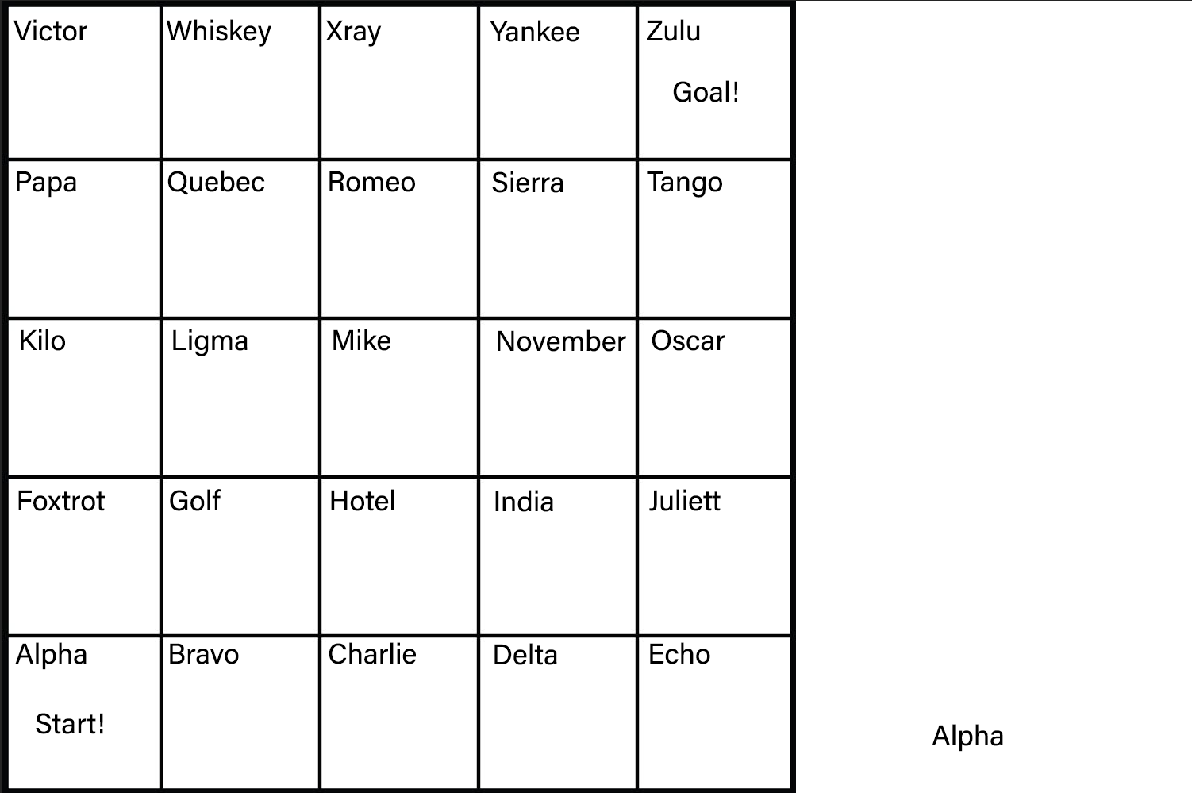

Slide 6
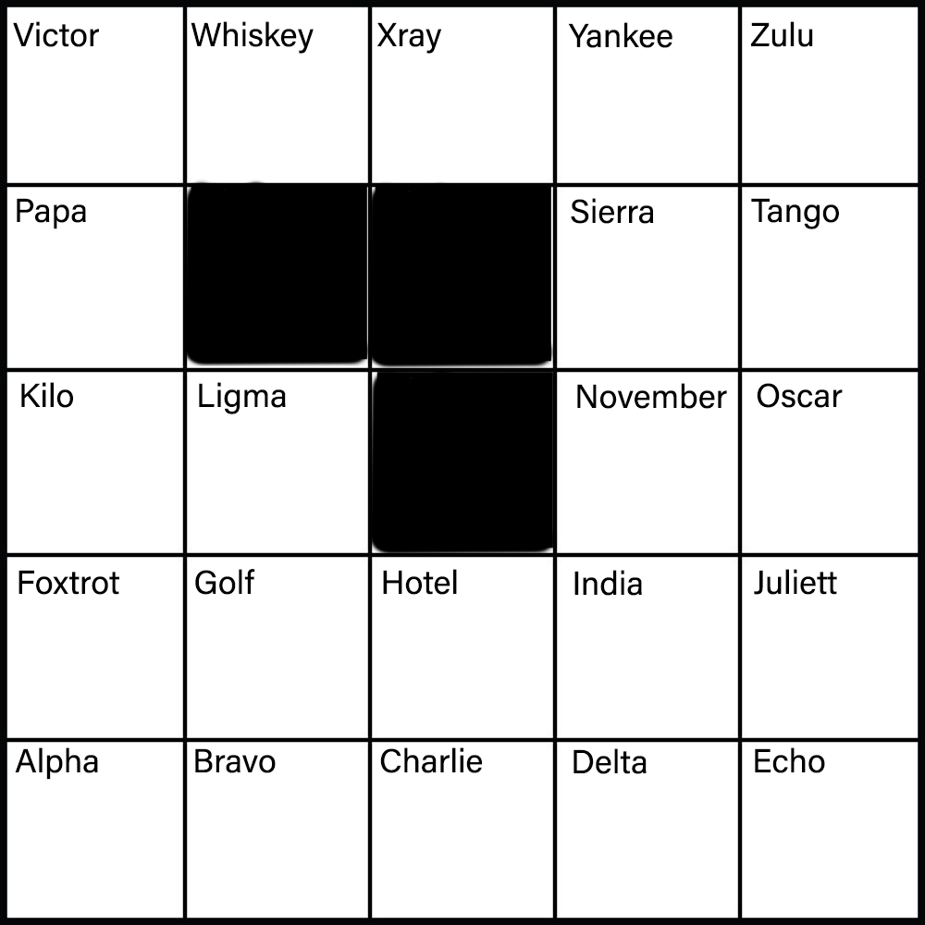

Slide 7
Activity: Practicing Pathfinding
Download and work through Grid 2 to 4
Work through each one first with BFS and record the finding path
Do the same with DFS for each grid
Discuss as a class how the two methods seem to behave based on the layouts

